Slide 1
Heart Attack Prediction
Group Members:
Adish Bhagwat
Yashowardhan Samdhani
Arya Srivastava
Sanjith
S. Sanjith

Slide 2
CONTENTS
Project Objective & Scope​
Data Description​
Methodology​
Data Preprocessing​
Models Used​
Accuracy Comparison​
Inference​
Future Scope of Improvements​
Acknowledgement

Slide 3
Project Objective
Objective :
Given : A data containing several reports of patients
Objective : To predict weather a heart attack occurs to a patient
Finally : Analyze and predict the probability of a heart attack
Scope :
Less error prone prediction of the occurrence of a heart attack
Cuts down the time taken for going through report data
Helps and informs Doctors whether a patient is in need of much attention or can be attended to without haste.

Slide 4
Data Description
Attribute information
Data Type:
1) Age
2) Sex
3) Chest pain type (4 values)
4) Resting blood pressure
5) Serum cholesterol in mg/dl
6) Fasting blood sugar > 120 mg/dl
7) Resting electrocardiographic results (values 0,1,2)
8) Maximum heart rate achieved
9) Exercise induced angina
10) Old peak = ST depression induced by exercise relative to rest
11) The slope of the peak exercise ST segment
12) Number of major vessels (0-3) colored by fluoroscopy
13) Thal : 0 = normal; 1 = fixed defect; 2 = reversable defect
14) target: 0= less chance of heart attack 1= more chance of heart attack
1) Age = Continuous
2) Sex = Categorical
3) CP (4 values) = Categorical
4) Trestbps = Continuous
5) Chol in mg/dl = Continuous
6) fbs > 120 mg/dl = Categorical
7) restecg (values 0,1,2) = Categorical
8) thalach = Continuous
9) exang = Categorical
10) old peak = Continuous
11) slope = Categorical
12) ca = Categorical
13) Thal = Categorical
14) Target = Categorical

Slide 5
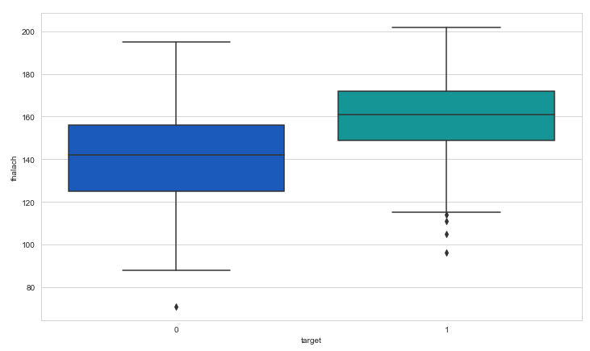
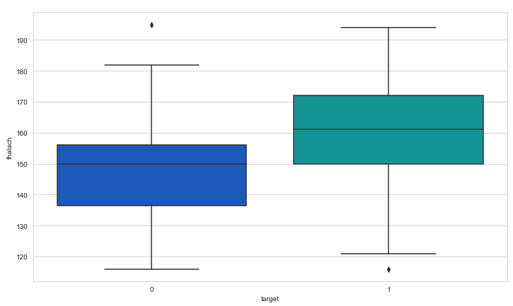
Data Preprocessing

Slide 6
Models Used
Naive Bayes
Decision Tree
Regression
(Logistic)
K – NN

Slide 7
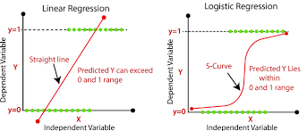
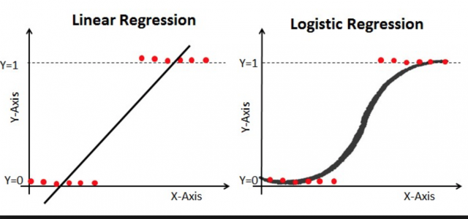
Logistic regression
Logistic Regression is the appropriate regression analysis when the dependent variable is dichotomous (binary).
Like all regression analyses, the logistic regression is a predictive analysis.

Slide 8
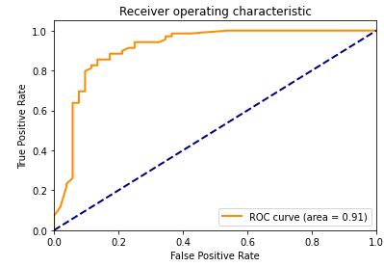
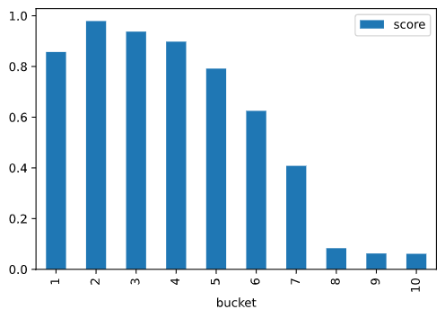
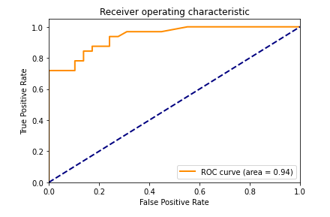
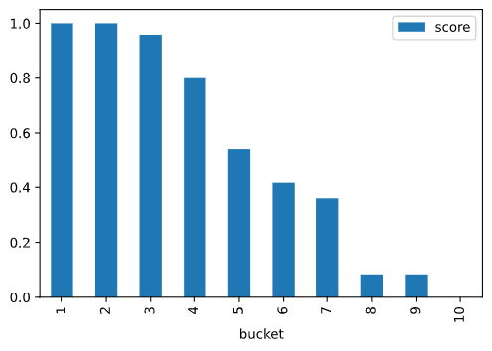

Slide 9
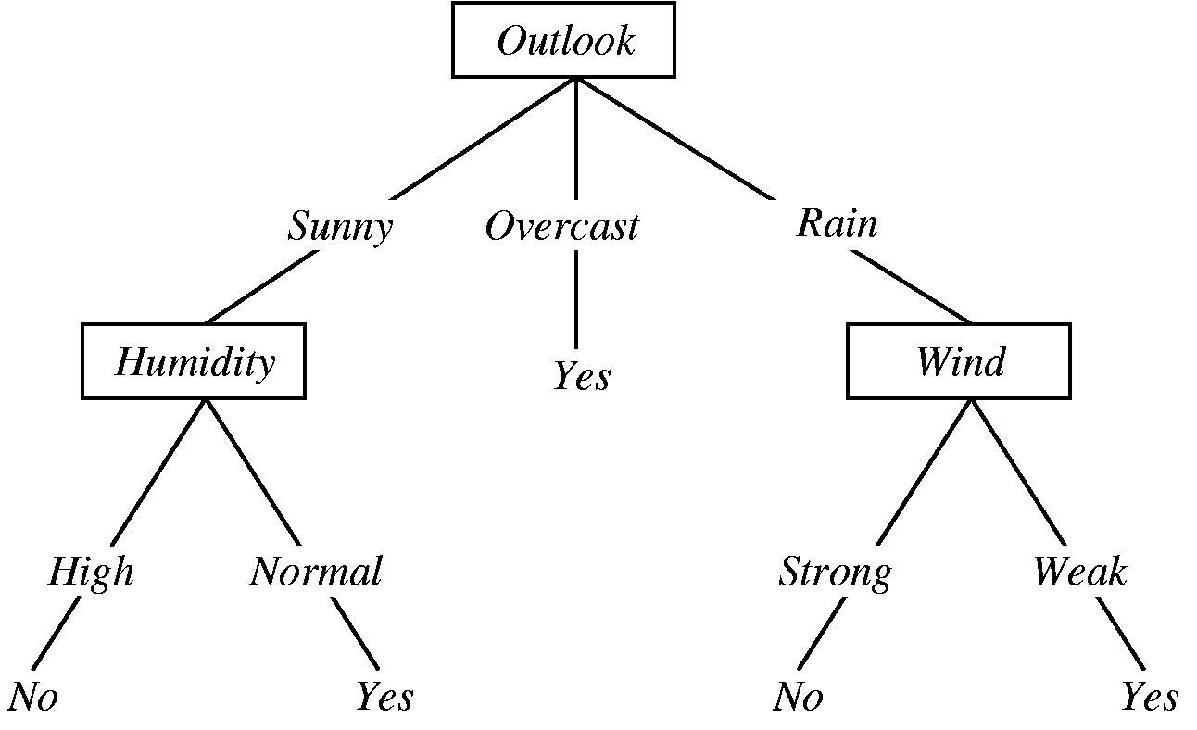
Decision Tree​
A decision tree is a graphical representation of specific decisions.
The main components of a decision tree involve points represented by nodes, actions and specific choices.
Each rule within a decision tree is represented by tracing a series of paths from root to node to the next node until an action is reached.​

Slide 10
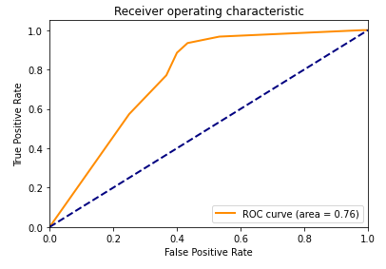
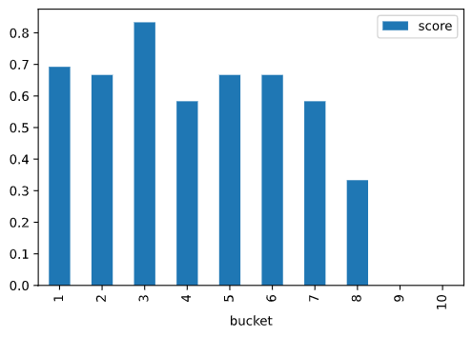
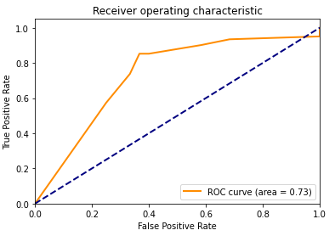
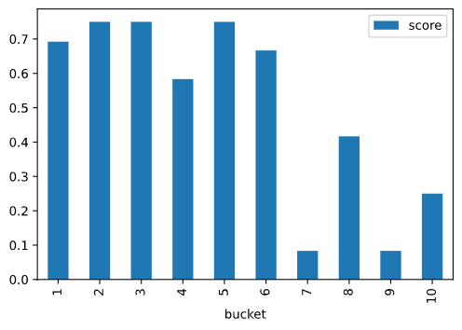

Slide 11
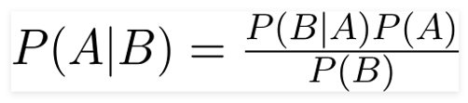
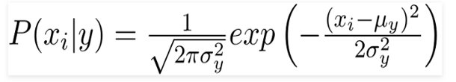
Naive bayes
It is a classification technique based on Bayes’ Theorem.
This extension of naive Bayes we have used is called Gaussian Naive Bayes.
The Gaussian (or Normal distribution) is the easiest to work with.

Slide 12
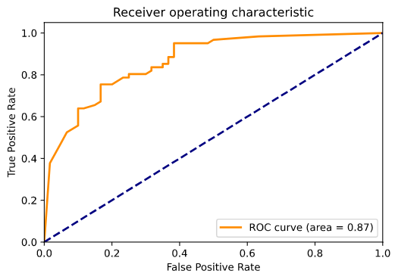
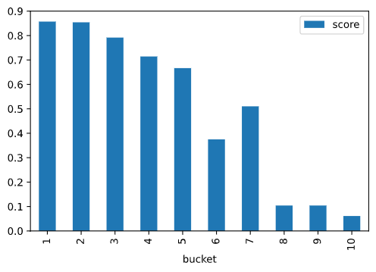
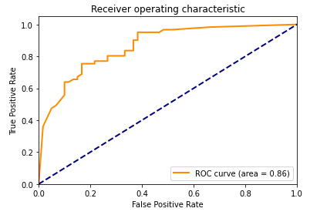
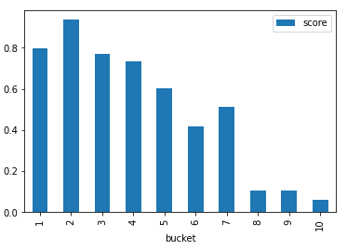

Slide 13
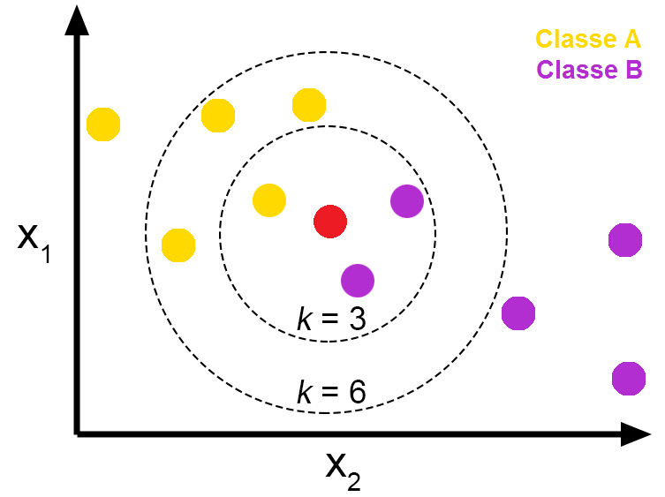
K Nearest Neighbor
A k-nearest-neighbor algorithm, (K-NN), is an approach to data classification.
It estimates how likely a data point is to be a member of one group.

Slide 14
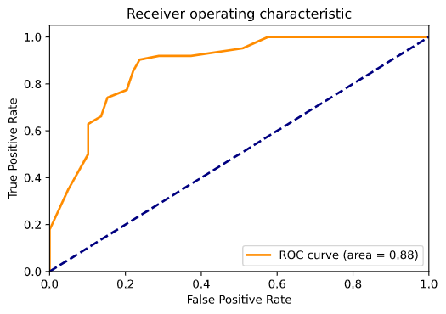
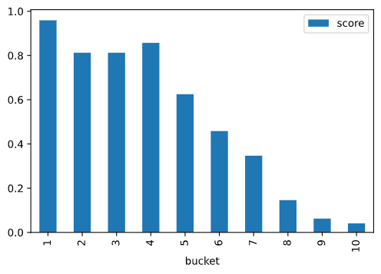

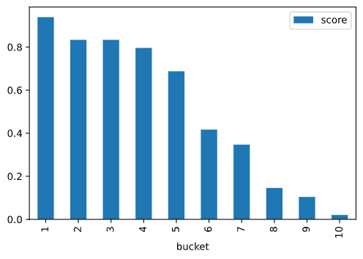

Slide 15
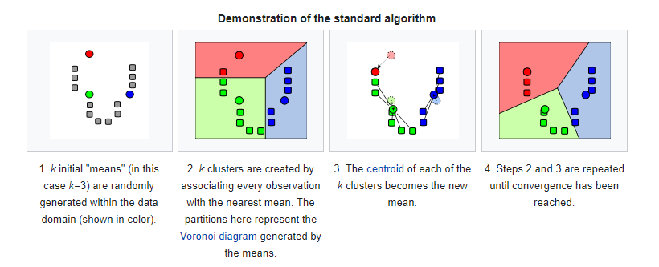
K-Means
k-means clustering is a method that aims to partition n observations into k clusters
In K-Means each observation belongs to the cluster with the nearest mean

Slide 17
Future scope of Improvement
The project includes only a small sample set and works through only 5 models. Keeping that in mind:
The project can be bettered by the collection and implementation of more data with more accurate values.
The dataset can also be passes through more models to check their compatibility to check which model suits the dataset the best.

Slide 18
Acknowledgement
I take this opportunity to express my gratitude and deep regards to my faculty Prof. Arnab Chakraborty for his exemplary guidance, monitoring and constant encouragement throughout the course of the project. The blessing, help and guidance given by him from time to time shall carry me a long way in the journey of life on which I am about to embark.
I am obligated to my project team members for the valuable information provided by them in their respective fields. I am grateful for their cooperation during the period of my assignment
Yashowardhan Samdhani
Adish Bhagwat
Arya Srivastav
S. Sanjith

